Slide 1
Finstagram
Team Name: Mind-MAP
Team Members: Akshay Phapale - 1316563
Ankita Brahmankar – 1389907
Prasad Aroskar – 1305905
Shiva Koduri – 1023015
Course: INFO 6150 – Web Design & User Exp.
Professor’s Name: Prof. Amuthan Arulraj

Slide 2
Outline
Introduction
Features
Architecture
Demo
Jest Testing
Work Distribution
Challenges
Future Scope

Slide 3
Introduction
A social networking platform to connect & share your messages/photos with your family & friends
Technology stack:
Node js
React
HTML
SCSS
Redux
Boot Strap
Mongoose
Mongo DB
Redux Thunk
Javascript
Express

Slide 4
Features
Managing friend requests
Google, Facebook Oauth
Uploading multiple images as posts
Add comments / Like posts
Unit testing – Jest
Private profiles
Send Messages
Search friends
Wall
Add comments / Like posts

Slide 5
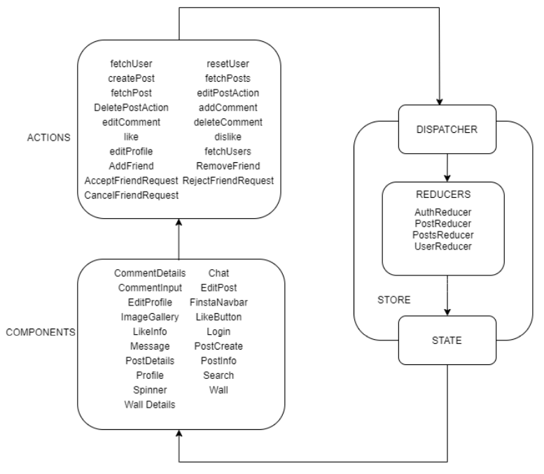
Architecture

Slide 6

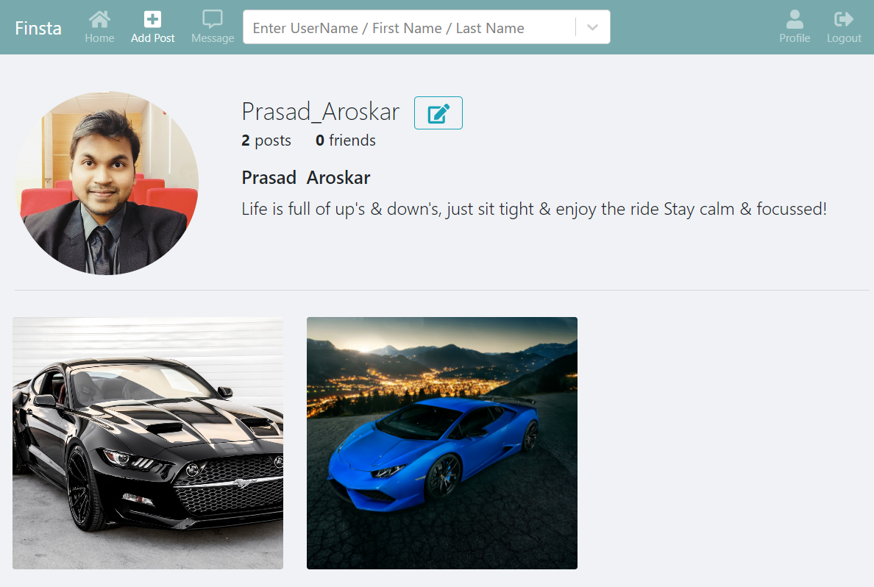
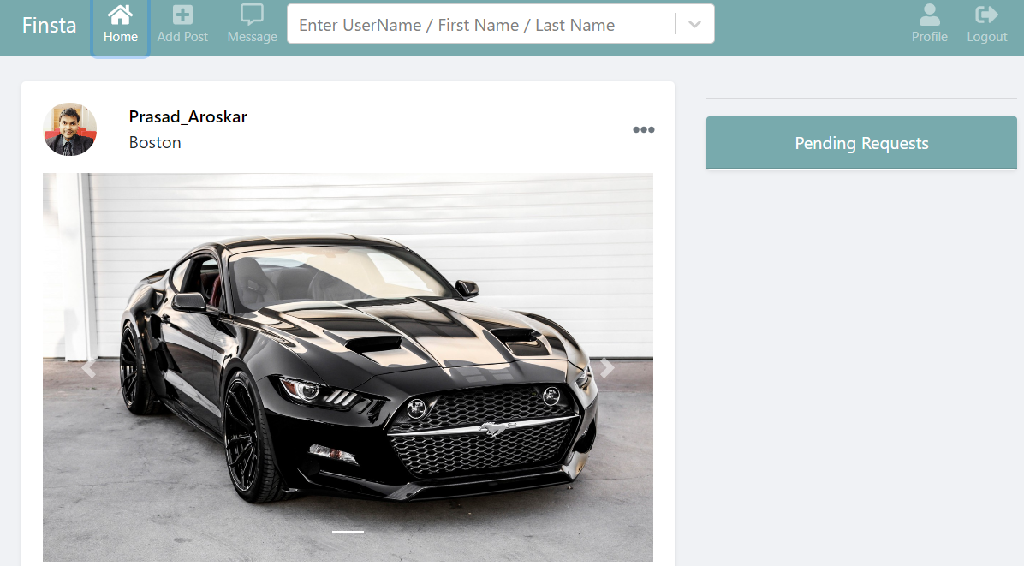
Demo

Slide 7
Work Distribution
Akshay
CRUD – Posts, Comments, Likes - (Frontend & Backend)
Ankita
CRUD – Profile(Frontend & backend)
Friend Request backend
Prasad
Oauth login – Google, Facebook (Frontend, Backend)
Profile UI
Shiva
Wall
Messaging
Profile UI
Navbar
Friend Request UI
Friend Suggestions
Search Bar
Post – Modal display
Sorting posts on Wall & Profile
Manual testing
Presentation
Attempted incorporating Jest unit testing

Slide 8
Challenges
Managing Oauth
Updating redux state
Handling images on server
Component reusability
Creating socket connection
Managing project remotely

Slide 9
Future Scope
Block users
Pagination
Store chat history in database
Adding videos in post

Slide 10
Links
GITHUB repo:
https://github.com/neu-mis-info6150-fall-2020/final-project-mindmap

Slide 11
Thank you
Any questions ?

